Slide 1

UMD Green Terp Program
By: Vincent, Swathi, Conrad

Slide 2
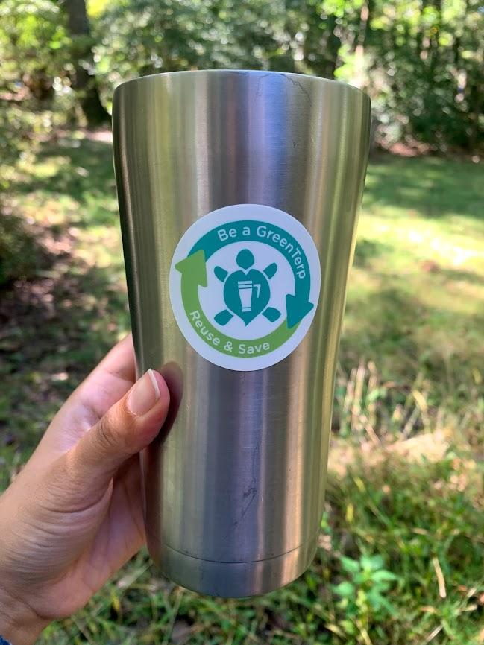
Overview
Explain why the Green Terp is there and the problems that we are facing.
Go through the data that was collected. Demographics, Location, Habits.
Why not as many completion?
Our solutions, and ideas.

Slide 3

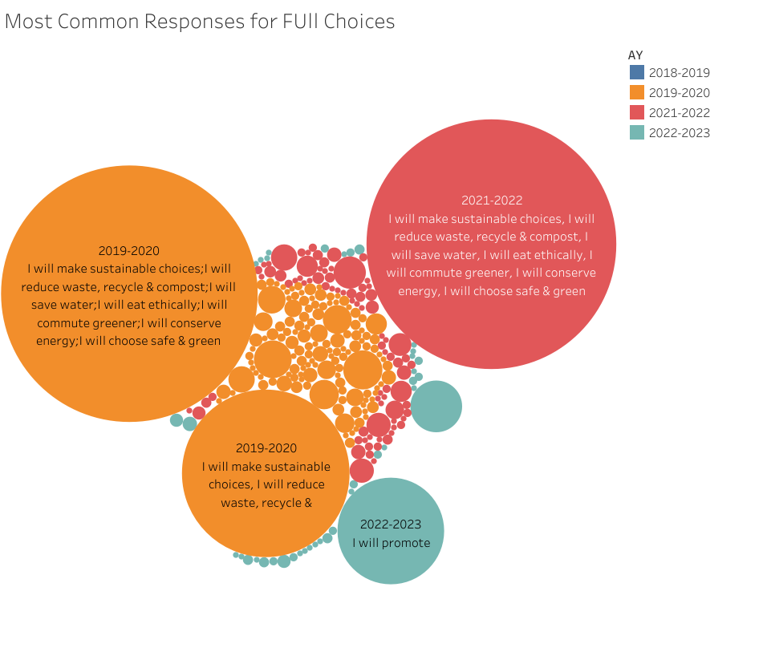

Green Terp Program
This program was open to all UMD student to reward them to live a healthier and sustainable lifestyle. It allows to not only help the campus but the world.

Slide 4
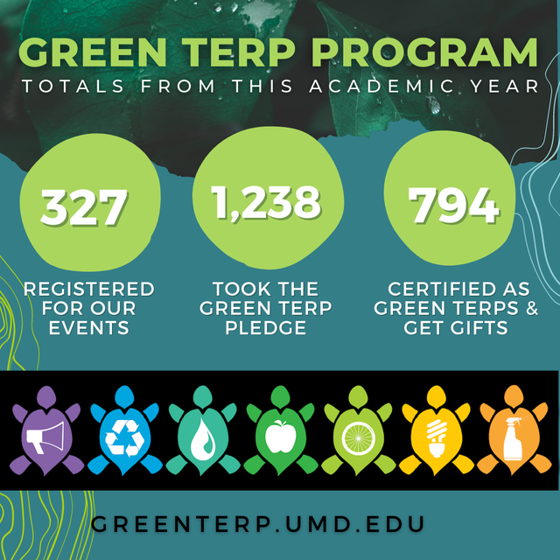

Green Terp Program
Let's look at how UMD has organized their participants and look at how many students are in this program.

Slide 5
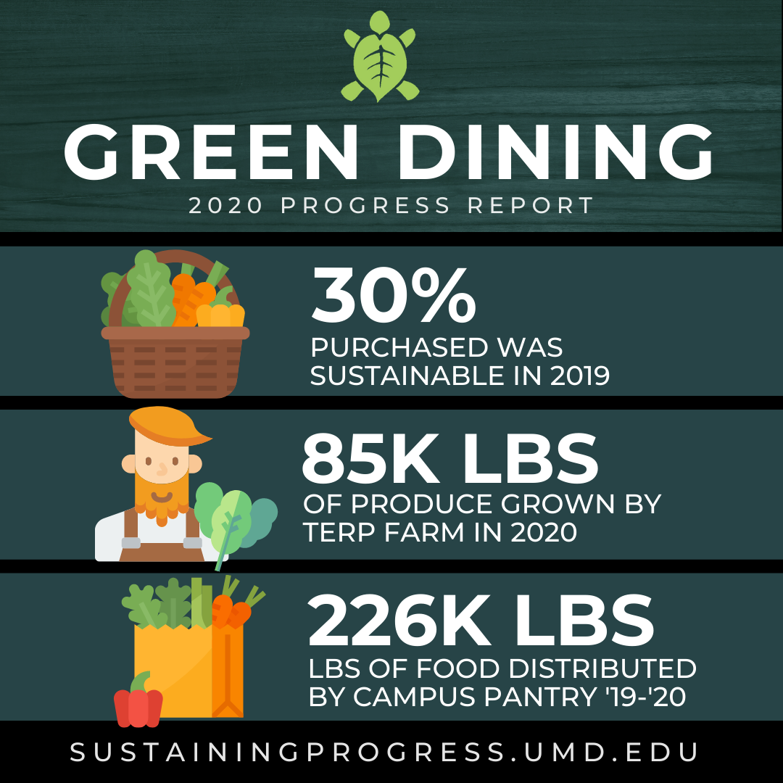
Green Terp Program
Let's look at how UMD has organized their participants and look at how many students are in this program.
In 2021, this was how the program did

Slide 6
Green Terp Program
Let's look at how UMD has organized their participants and look at how many students are in this program.
These are the habits the program wants to see
In 2021, this was how the program did

Slide 7
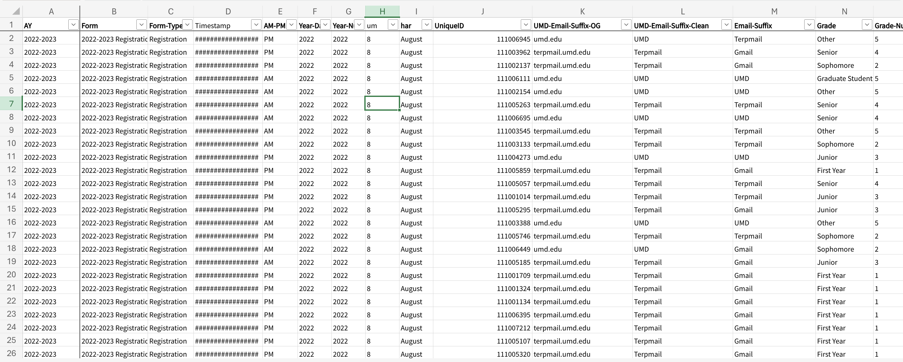
Green Terp Program
Let's Dive in
Data from 2019-2020
These are the habits the program wants to see

Slide 8
Green Terp Program
Let's Dive in
But what about all the other data?
These are the habits the program wants to see

Slide 9
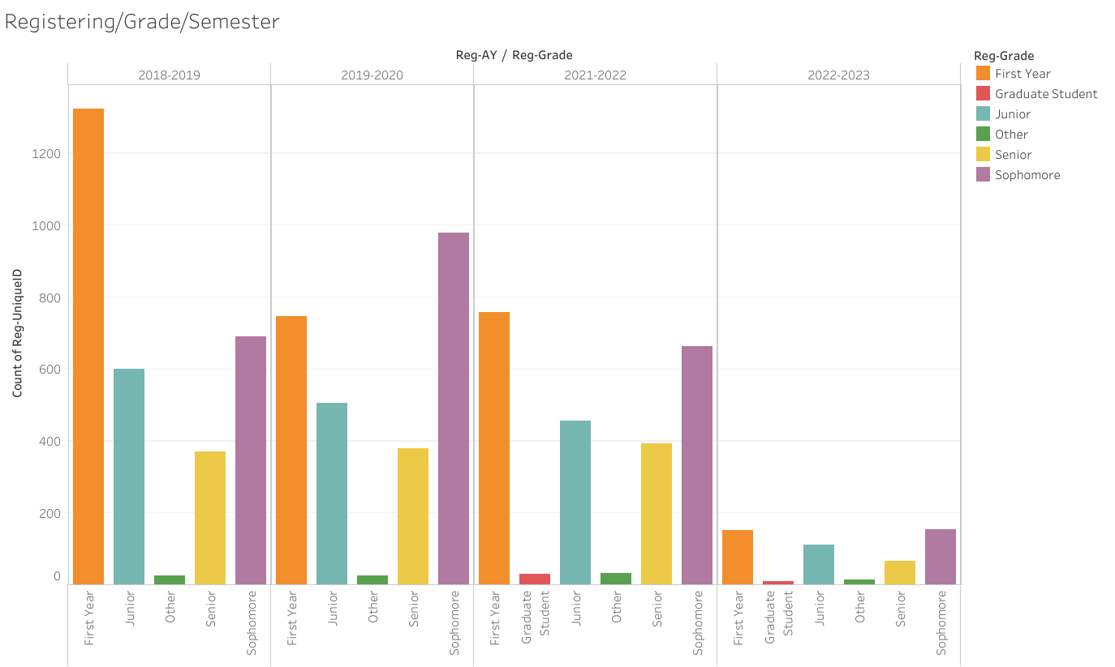
Green Terp Program
DATA
But what about all the other data?
Let's Dive in
How can I understand all of this?
These are the habits the program wants to see

Slide 10
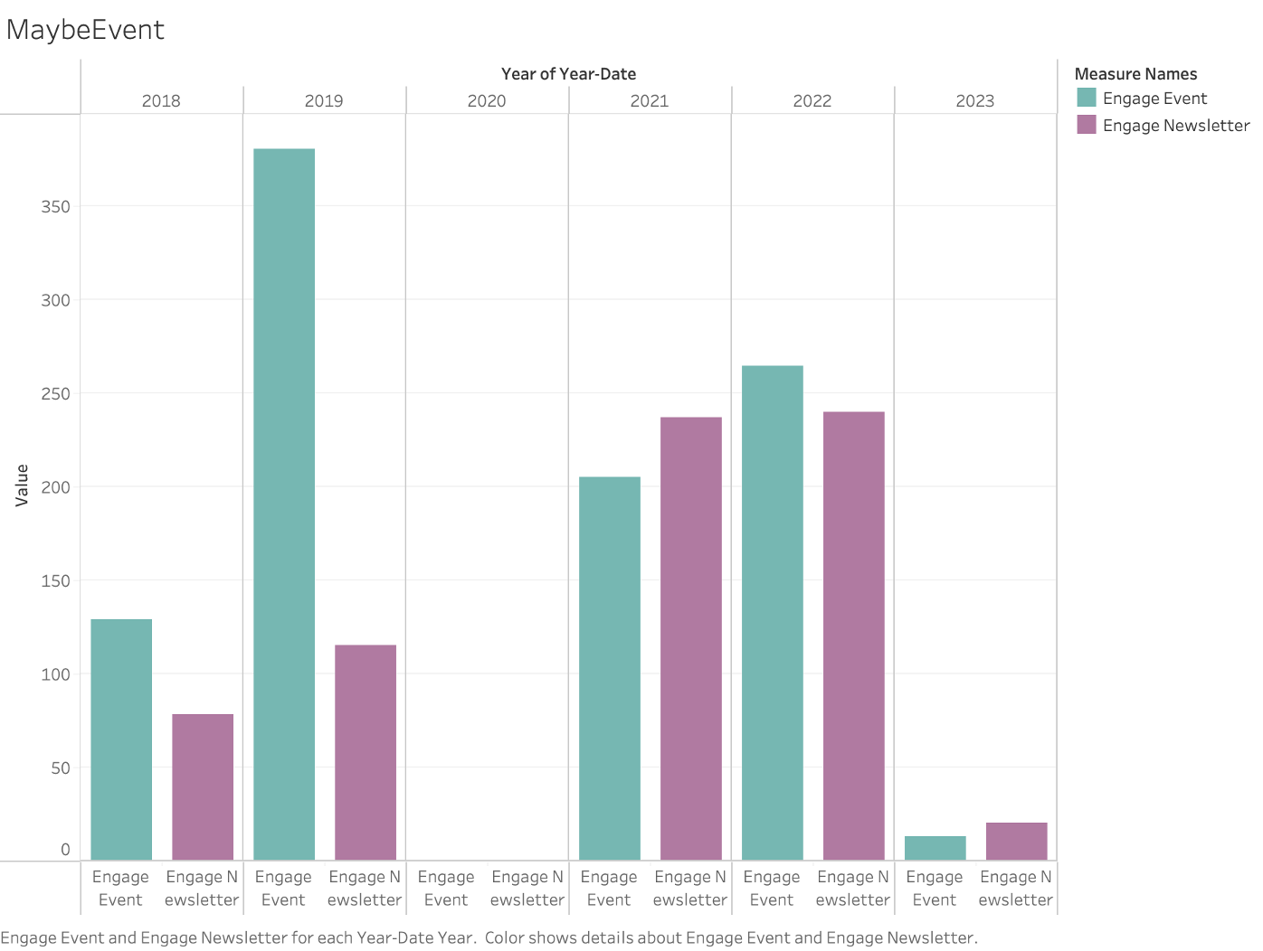
Green Terp Program
DATA
Let's talk about Registration
Let's Dive in

Slide 11
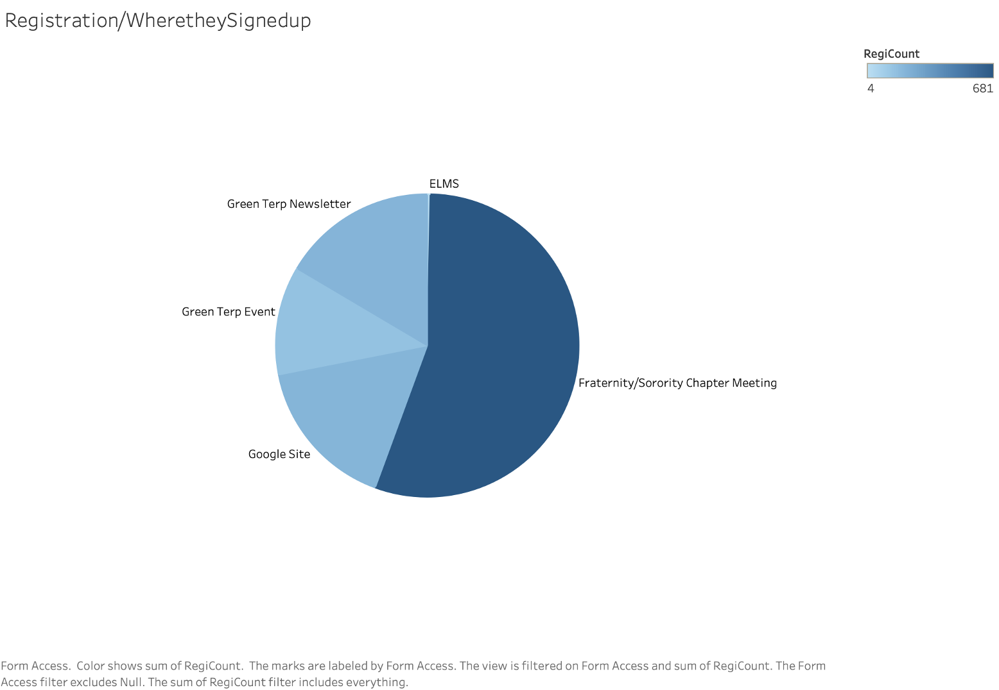

Green Terp Program
DATA
Registration
Let's Dive in

Slide 12
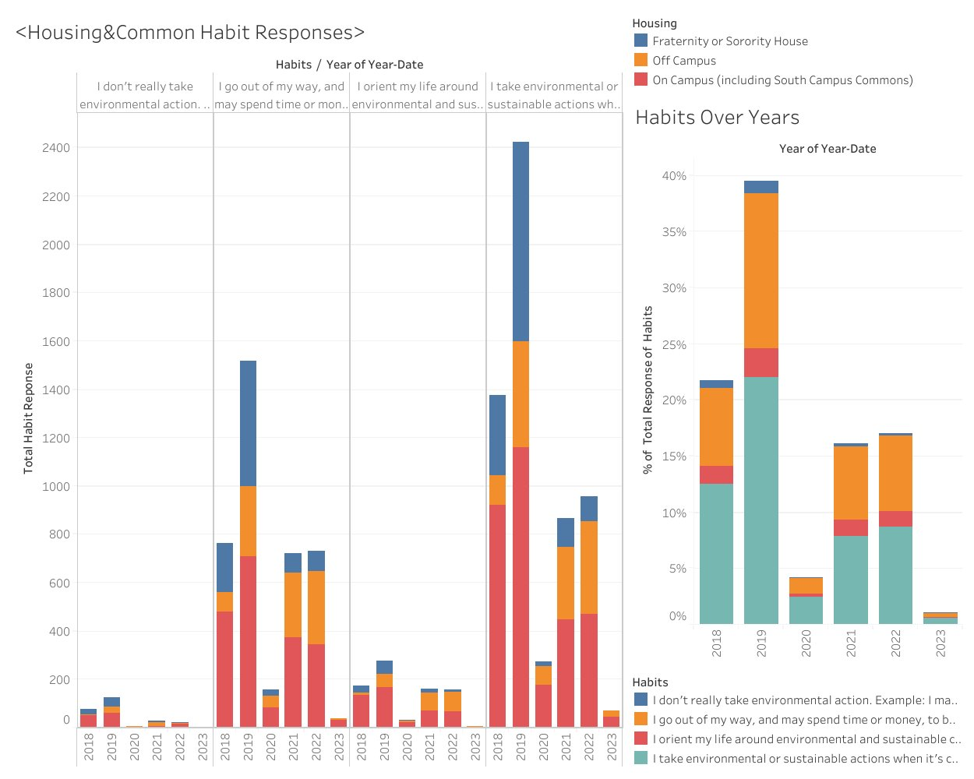
DATA
What about the people? Who is being targeted?

Slide 13
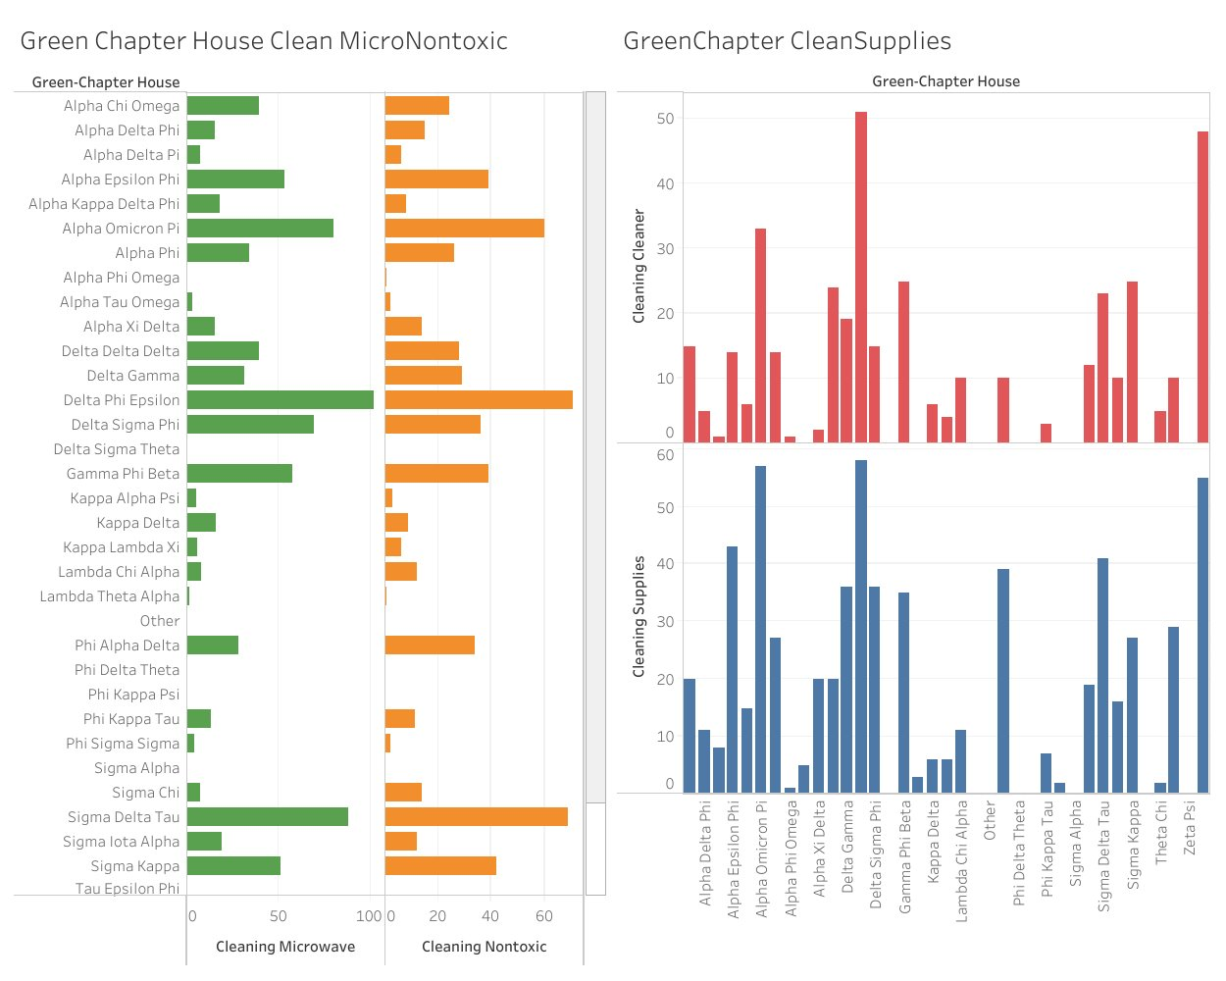
DATA
What type of habits would you choose?

Slide 14
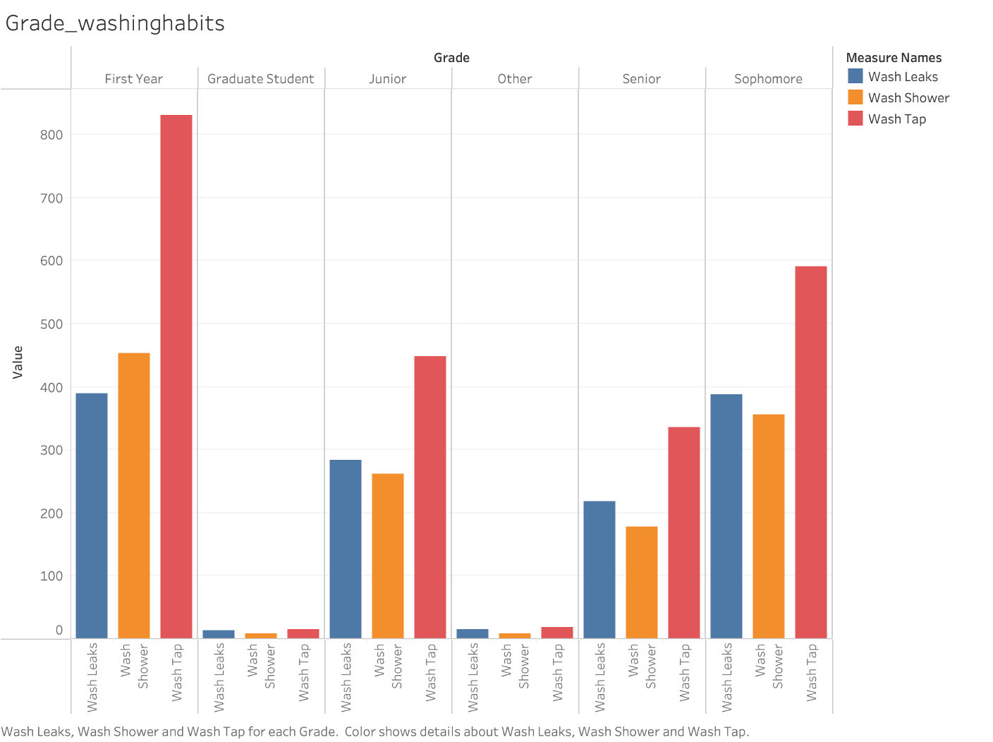
DATA
Greek life, more like green life.

Slide 15
DATA
What did they do for the cause?

Slide 16
Problems we identified.
Completion to Registration ratio was not good. Why?
Notes:
Speak not Words: our main goal was to try and get this Green terp programs completion up. Many people are registering and sharing with friends but the completion number drops.
-One month Peak per semester
-Certain demographics
-All depends on what graphs we put

Slide 17
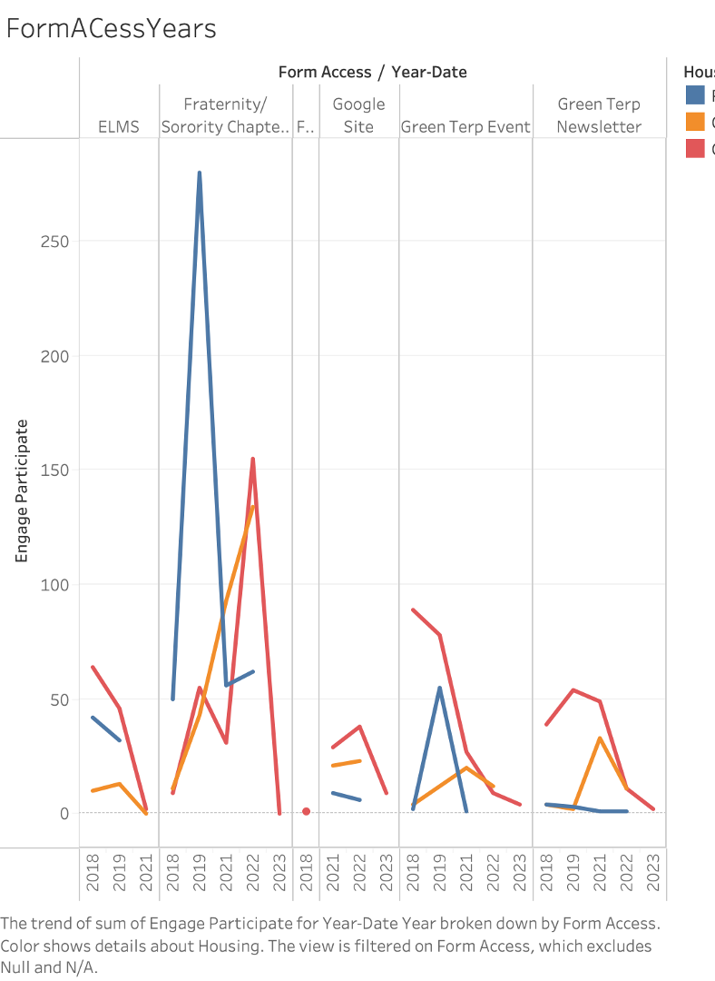
Problems we identified.
Demographics, Who are we targeting.
Who should we be targeting?
Notes:
Not reading, Saying: After analyzing the data we notice there are certain groups of people that are missing out or not targeted. We see a lot of our Greek Life are much more active in completing and registering then other regular students We also see Freshman and Sophomores are more caring about our school while the upperclassmen have basically given up on the campus.

Slide 18
Our ideas.
Source:
Go over graph and come up with this
How can we maximize our registration and completion? Who should we focus on? Where should we put our energy in? How?

